Slide 1
CRIME MAPPING week 2 – activity 4
NIRBHAY ASHOK PHERWANI
https://nirbhay.me

Slide 2
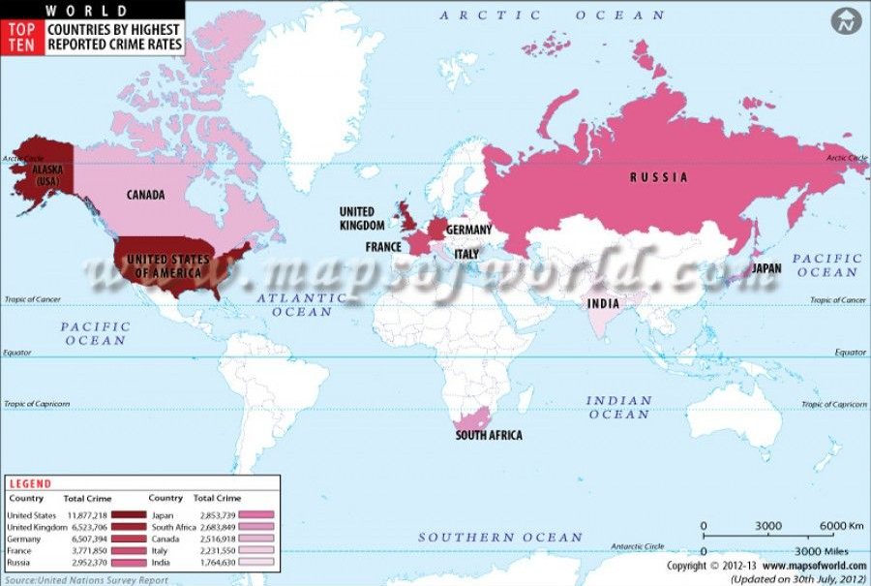

Slide 3
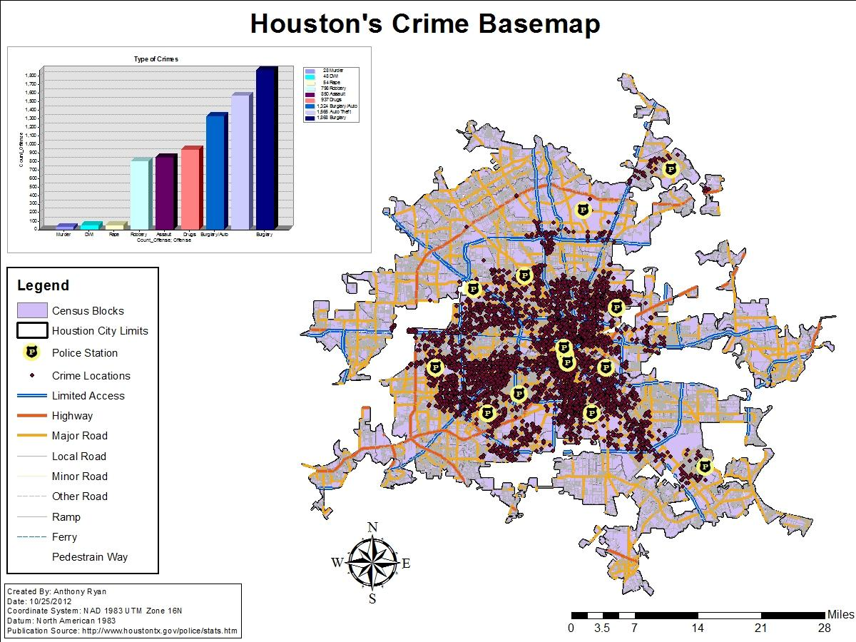

Slide 4
https://www.arcgis.com/home/webmap/viewer.html?webmap=8d15d99dc973499d8f93860298b3e576

Slide 5
THANK YOU FOR WATCHING!

